Slide 1
DBMS Relational Database Design

Slide 2
Outline
Pitfalls in Relational database design
Concept of Normalization
Function Dependencies
First Normal Form
2nd,3rd,BCNF
Multivalued dependencies
4NF

Slide 3
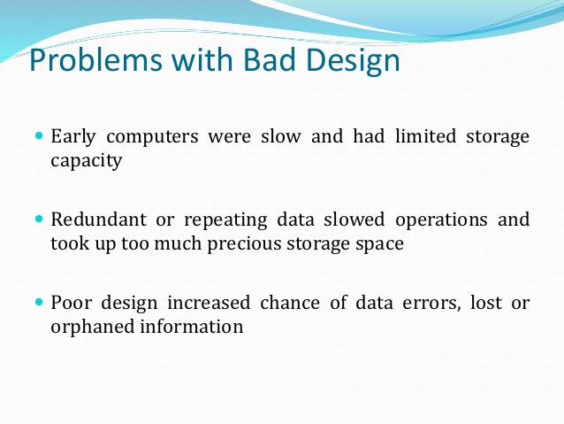

Slide 4
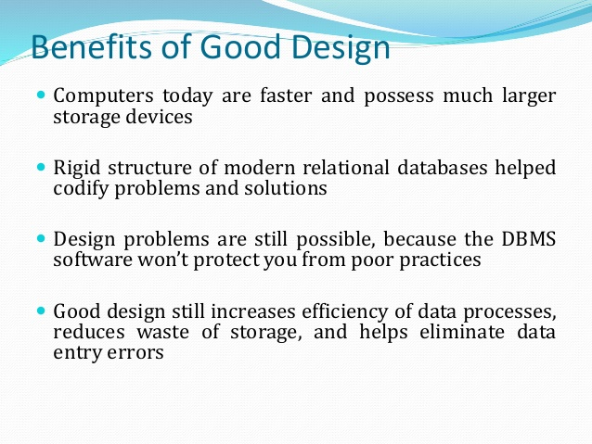

Slide 5
Pitfalls in Relational DB Design
A bad design may have several properties, including:
Repetition of information.
Inability to represent certain information.
Loss of information
Dependency of various attributes of relation

Slide 6
1. Redundant Data
Redundancy is root of many problems.
Redundant data causes following problems
Insert delete update anomaly
Wastage of storage
Generation of invalid data

Slide 7
Eid | Ename | Addr | Proj_id | Project | Salary
1 | Rohan | VIRAR | 12 | YACC | 10K
2 | Mohan | VASAI | 23 | C | 20K
3 | Sohan | Borivali | 34 | C++ | 30K
1 | Rohan | VIRAR | 45 | JAVA | 10K
2 | Mohan | VASAI | 43 | .NET | 20K
3 | Sohan | Borivali | 21 | PHP | 30K

Slide 8
Both the tables employee and project are kept together
Adding a new row to table we need to give information about both the tables.
Bad design

Slide 9
2. Inability to represent some data
In table we should have at least one record to display.
Difficult to handle null values.

Slide 10
3. Dependency of various attributes of relation
Primary key, foreign key

Slide 11
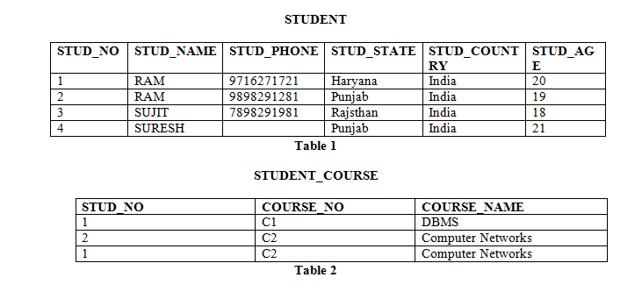

Slide 12
Insertion anomaly: If a tuple is inserted in referencing relation and referencing attribute value is not present in referenced attribute, it will not allow inserting in referencing relation. For Example, If we try to insert a record in STUDENT_COURSE with STUD_NO =7, it will not allow.

Slide 13
Deletion and Updation anomaly: If a tuple is deleted or updated from referenced relation and referenced attribute value is used by referencing attribute in referencing relation, it will not allow deleting the tuple from referenced relation.
For Example, If we try to delete a record from STUDENT with STUD_NO =1, it will not allow.

Slide 14
4. Loss of Information
Relational database design gives us summary of information in form of tables,
In that case we may loss some info
Eg: Every student have different grasping power.
We can not represent grasping power.

Slide 15
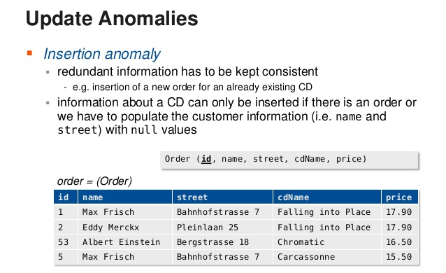

Slide 16
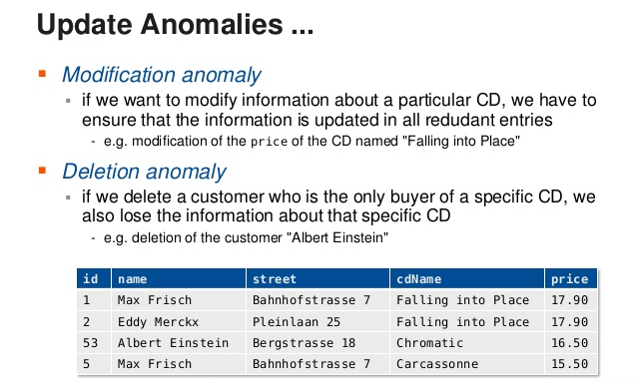

Slide 17
https://www.slideshare.net/kosalgeek/database-normalization-1nf-2nf-3nf-bcnf-4nf-5nf

Slide 18
Update Anomalies happen when the person charged with the task of keeping all the records current and accurate, is asked,
for example, to change an employee’s title due to a promotion.
If the data is stored redundantly in the same table, and the person misses any of them, then there will be multiple titles associated with the employee.
The end user has no way of knowing which is the correct title.

Slide 19
Employee_id | Ename | Etitle | Arrdr
001 | Rohan | Jr.Clerk
002 | Mohan | Sr.Clerk
001 | Rohan | Jr.Clerk
003 | Sohan | Manger
001 | Rohan | Jr.Clerk
004 | Arohan | Technical manger

Slide 20
Insertion Anomalies happen when inserting vital data into the database is not possible because other data is not already there.
For example, if a system is designed to require that a customer be on file before a sale can be made to that customer, but you cannot add a customer until they have bought something, then you have an insert anomaly.

Slide 21
Cid | Custname | sales

Slide 22
productid | Product name | Salesmanid | Salse name | salary

Slide 23
Deletion Anomalies happen when the deletion of unwanted information causes desired information to be deleted as well.
For example, if a single database record contains information about a particular product along with information about a salesperson for the company and the salesperson quits, then information about the product is deleted along with salesperson information.

Slide 24
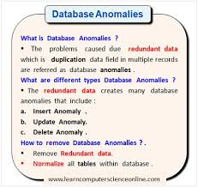

Slide 25
https://www.youtube.com/watch?v=xoTyrdT9SZI&t=5s

Slide 26
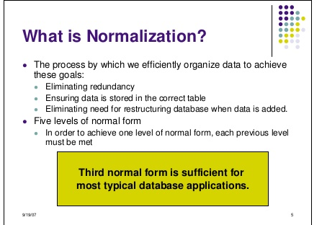

Slide 27
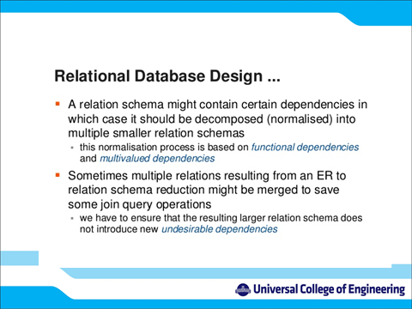

Slide 28
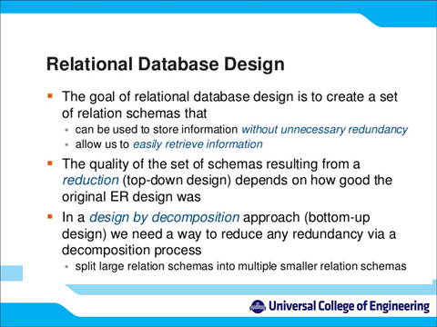

Slide 29
Thank you !

